Slide 1

Data allocation in Distributed database
Calculating cost of a solution to data allocation problem
Presented by – Nikhil Verma
Guided by – Dr. Shrutilipi Bhattacharjee

Slide 2
Solution to data allocation problem
Solution to DAP is a vector of dimension 1Xm where m is the number of fragments and range of values in a solution will be an integer value between 0 and n-1, where n is the number of sites.
A sample solution representation for 20 fragments and 4 sites.

Slide 3
Generating dataset for solving the data allocation problem
The purpose of data allocation problem(DAP) is to determine a placements of fragments at the best different sites so as to minimize the total transaction cost when a query is taken from one site to another.
Firstly, a dataset is required to solve the DAP. The dataset contains n sites, m fragments, and l transactions.
The dataset containing sites, fragments and transactions is constructed according to the following formulas.

Slide 4
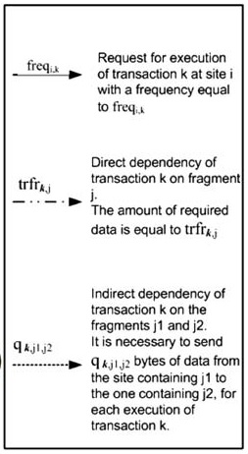
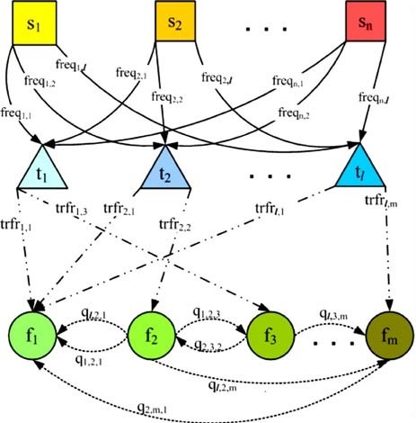
Dependencies among sites, transactions and fragments

Slide 5
Generating dataset for solving the data allocation problem
Site Fragment Frequency (FREQ) matrix contains frequency values among sites transaction and is used to access transaction to sites. Dimension of FREQ is n X l.
Transaction to Fragmentation (TRFR) matrix is used in order to access transaction to fragmentation. Dimension of TRFR is l X m.
TRFR matrix includes some parameters such as relationship of transactions amount data which are required for fragments dependency. Q matrix refers to data between two fragments of a transaction. Each fragments size i at interval [c/10, 20*c/10]. Which is chosen randomly. Where c is a value at interval [10, 1000]. To generate values of TRFR matrix 0 or 1 are generated randomly. Subsequently random numbers between 0 and fragment size for the 1’s are produced and then we multiply the matrix with Access Probability to Fragment (APF). APF is chosen randomly in range [0,1].

Slide 6
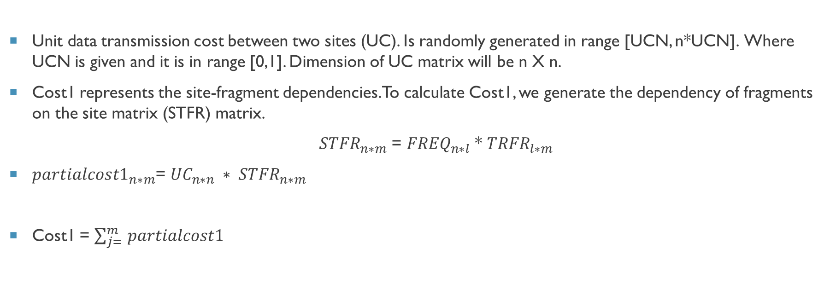
Generating dataset for solving the data allocation problem
Unit data transmission cost between two sites (UC). Is randomly generated in range [UCN, n*UCN]. Where UCN is given and it is in range [0,1]. Dimension of UC matrix will be n X n.
Cost1 represents the site-fragment dependencies. To calculate Cost1, we generate the dependency of fragments on the site matrix (STFR) matrix.
${STFR}_{n∗m}$ = ${FREQ}_{n∗l}$ * ${TRFR}_{l∗m}$
${partialcost1}_{n∗m}$= ${UC}_{n∗n} ∗ {STFR}_{n∗m}$
Cost1 = $\sum_{j= }^{m}{partialcost1}$

Slide 7
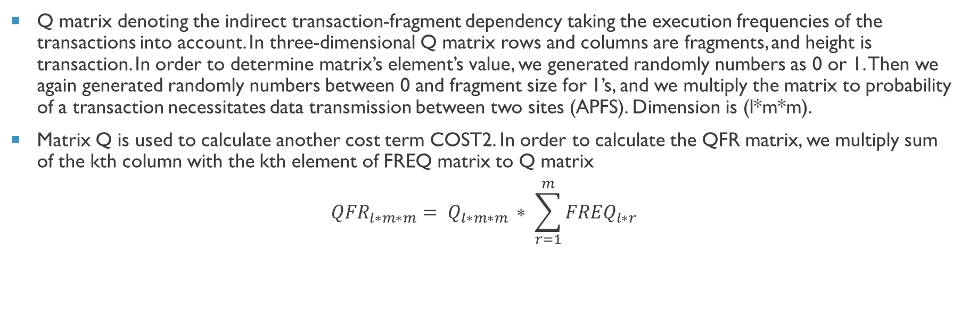
Generating dataset for solving the data allocation problem
Q matrix denoting the indirect transaction-fragment dependency taking the execution frequencies of the transactions into account. In three-dimensional Q matrix rows and columns are fragments, and height is transaction. In order to determine matrix’s element’s value, we generated randomly numbers as 0 or 1. Then we again generated randomly numbers between 0 and fragment size for 1’s, and we multiply the matrix to probability of a transaction necessitates data transmission between two sites (APFS). Dimension is (l*m*m).
Matrix Q is used to calculate another cost term COST2. In order to calculate the QFR matrix, we multiply sum of the kth column with the kth element of FREQ matrix to Q matrix
$${QFR}_{l∗m∗m}= Q_{l∗m∗m }∗ \sum_{r=1}^{m}{{FREQ}_{l∗r}}$$

Slide 8
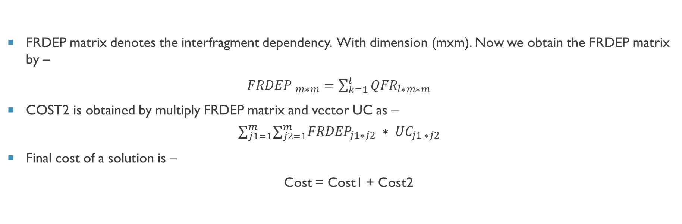
Generating dataset for solving the data allocation problem
FRDEP matrix denotes the interfragment dependency. With dimension (mxm). Now we obtain the FRDEP matrix by –
${FRDEP }_{m∗m}$ $=\sum_{k=1}^{l}{{QFR}_{l∗m∗m}}$
COST2 is obtained by multiply FRDEP matrix and vector UC as –
$$∑_{j1=1}^{m}∑_{j2=1}^{m}{FRDEP}_{j1∗j2} ∗ {UC}_{j1 ∗j2}$$
Final cost of a solution is –
Cost = Cost1 + Cost2

Slide 9

Thank You

